Slide 1

Foundational Data Analysis and Excel Function Implementation
By Swapna Macha

Slide 2
Project Brief
The Retail Sales Performance Analysis project focuses on understanding:
The Data
Product performance across various counties in England
Leveraged Excel tools such as:
PivotTables
SWITCH functions
Aggregate functions
Date functions
Vlookup
Xlookup
Data validation
Concatenation
Aims to:
Develop experience using various excel functions

Slide 3
Dataset Overview
Description:
The dataset includes retail sales information segmented by county and product, with key fields such as:
County: Represents the geographic region of the sales.
Product: Indicates the type of product sold
Sales Volume: Captures the number of units sold for each product.
Additional calculated metrics like categorization of sales into High, Medium, or Low using the SWITCH function.

Slide 4
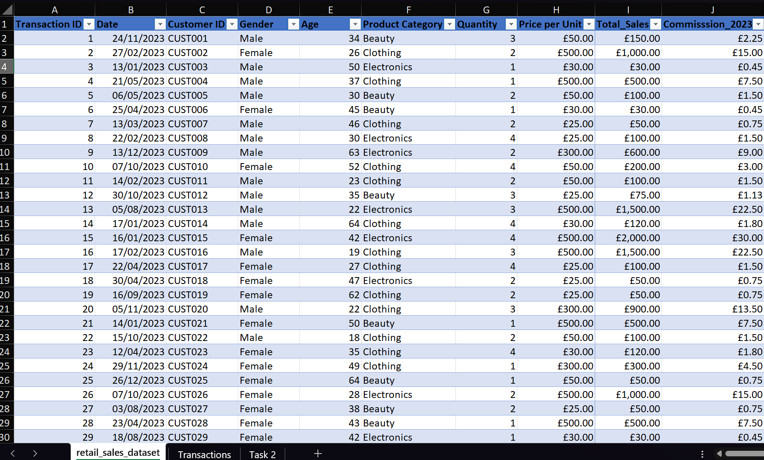
The dataset from the "retail_sales_dataset" sheet was organized into a structured table format.
This table enables easy sorting, filtering, and analysis of transaction details, customer demographics, and sales metrics.

Slide 5
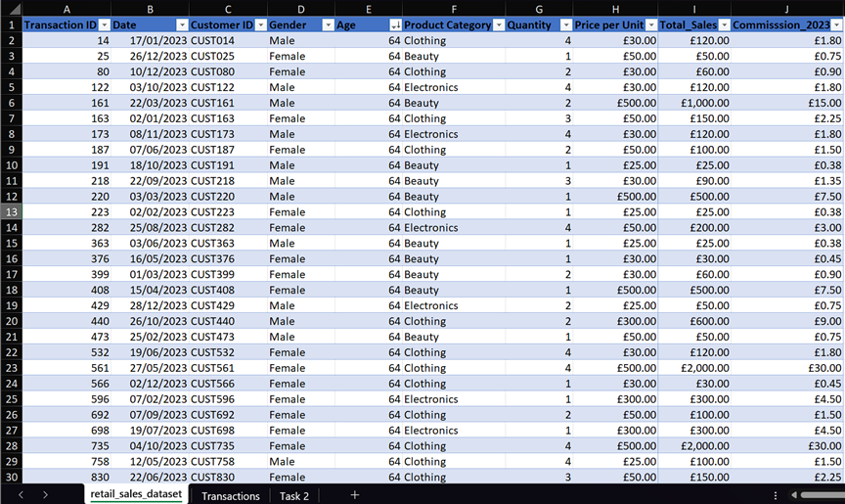
Using the ‘filter’ function, filtered ‘Age’ to ‘largest to smallest’

Slide 6
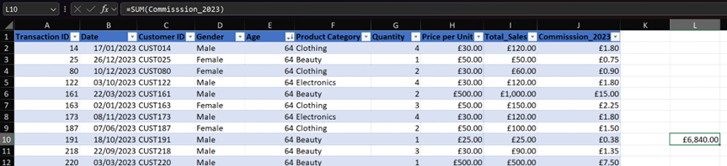
Using the ‘SUM’ function, showed the commission total in cell ‘L10’

Slide 7
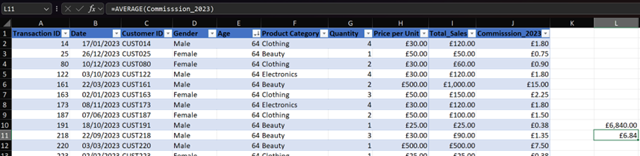
Using the ‘AVERAGE’ function, showed the average commission in cell ‘L11’

Slide 8
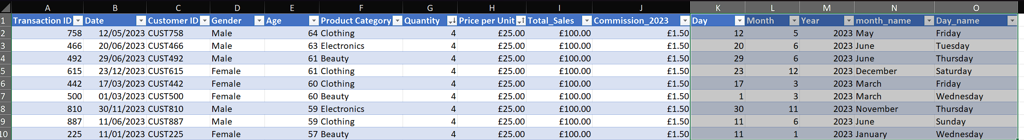
Extracted day, month, year, month_name, date_name from Date column

Slide 9
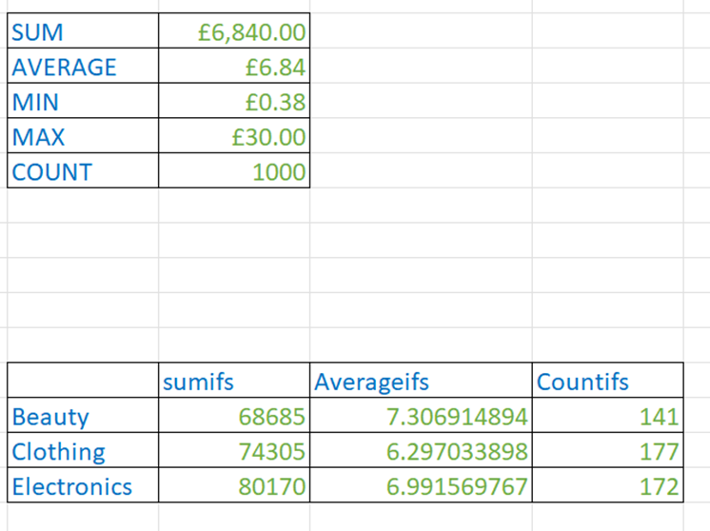
Applied Aggregate Functions to Summarize and Analyze Sales Data
’

Slide 10
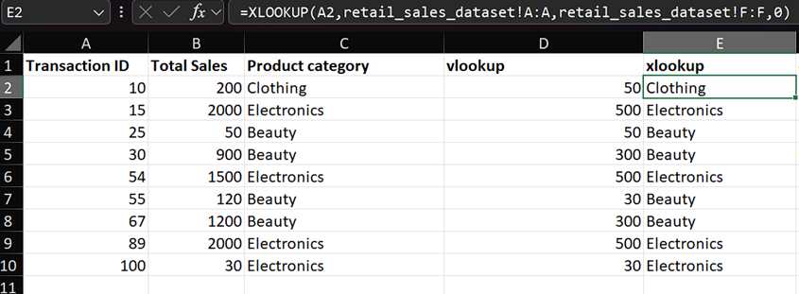
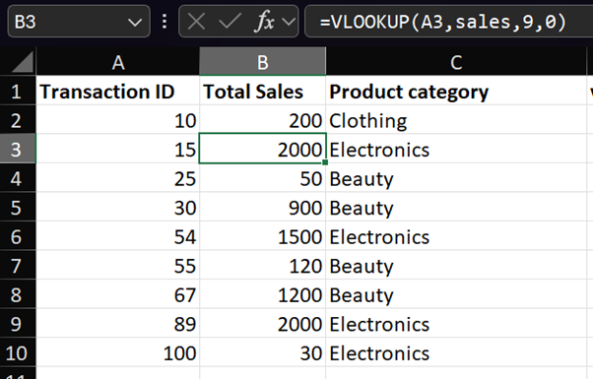
Utilized VLOOKUP and XLOOKUP Functions for Data Retrieval and Analysis

Slide 11
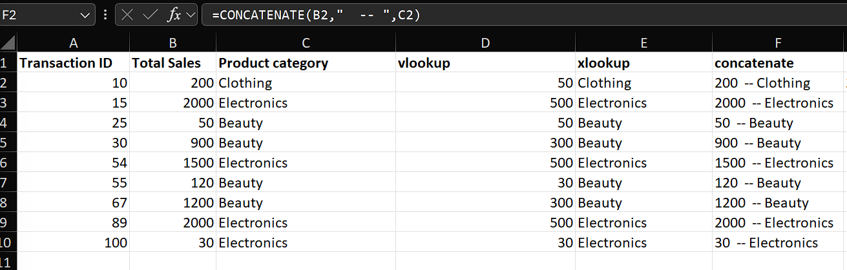
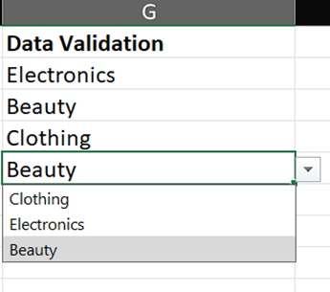
Applied Concatenation for String Combination and Data Validation for Controlled Inputs

Slide 12
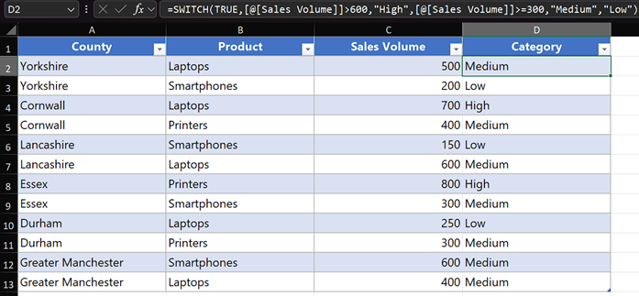
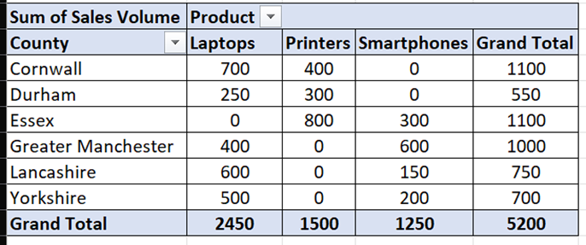
Created a Pivot Table to summarise the data by County in the rows and Products in the columns. Used Sales Volume as the value to be summarised.
Created a new column in the dataset categorising products by sales volume using the SWITCH function

Slide 13
Key Takeaways from the Project:
Gained hands-on experience in using essential Excel functions such as:
PivotTables: For summarizing data and analyzing trends.
SWITCH Function: For categorizing data into logical groups.
VLOOKUP and XLOOKUP: For retrieving data efficiently.
Aggregate Functions (SUM, AVERAGE): For calculating key metrics.
Concatenation and Data Validation: For enhancing data usability and accuracy.
Enhanced skills in data cleaning and transformation by:
Creating structured tables for easy filtering and sorting.
Extracting insights through calculated fields and formulas.
Strengthened problem-solving skills by identifying key trends, market performance.
Impact: This project provided a strong foundation in Excel-based data analysis and built confidence in applying advanced functions for real-world scenarios.

Slide 14
Thank You

